Slide 1
Steganography
CAPSTONE PROJECT
Presented By:
SHUBHAM PALIWAL
JECRC Foundation & Artificial Intelligence and Data Science

Slide 2
OUTLINE
Problem Statement
Technology used
Wow factor
End users
Result
Conclusion
Git-hub Link
Future scope

Slide 3
Problem Statement
Implementation of image-based steganography using OpenCV in Python, enabling users to securely embed and retrieve messages within an image using a password. It ensures confidentiality, prevents unauthorized access, and maintains metadata persistence for seamless encryption and decryption.

Slide 4
Technology used
Python – The primary programming language for implementation.
OpenCV (cv2) – Used for image processing and manipulation.
File Handling – To store metadata (password and message length) for decryption.
Operating System (os module) – To interact with the system for file operations and opening images.
System Requirements:
Hardware:
Minimum 4GB RAM (8GB recommended for better performance).
Processor: Intel i3 or higher (or equivalent AMD processor).
Storage: At least 500MB of free disk space.
Software:
Operating System: Windows
Python 3.6+ installed.
Required Python libraries: pip install opencv-python
A text editor or IDE (eg. VS Code)

Slide 5
Wow factors
Secure Message Embedding: Uses pixel manipulation to store secret messages within an image without altering its visible properties.
Password - Protected Decryption: Ensures that only authorized users can extract the hidden message using a correct passcode.
Metadata Storage for Persistence: Saves encryption details (password & message length) in a separate file, preventing data loss.
Minimal Image Distortion: The algorithm embeds messages efficiently while preserving the image quality.
Cross-Platform Compatibility: Works seamlessly on Windows, macOS, and Linux.
Lightweight & Efficient: Requires minimal storage and processing power, making it accessible for various devices.
Simple & User-Friendly Interface: Easy-to-use command-line interaction for encryption and decryption.

Slide 6
End users
Cybersecurity Professionals:
Use steganography for secure communication and data protection.
Journalists & Whistleblowers:
Hide confidential messages to protect sensitive information from surveillance.
Government & Intelligence Agencies:
Securely transmit classified data without raising suspicion.
Digital Forensics Experts:
Extract hidden messages from images for investigative purposes.
Privacy-Conscious Individuals:
Protect personal information from unauthorized access.
Educational Institutions & Researchers:
Teach and study steganography concepts in cybersecurity courses.

Slide 7
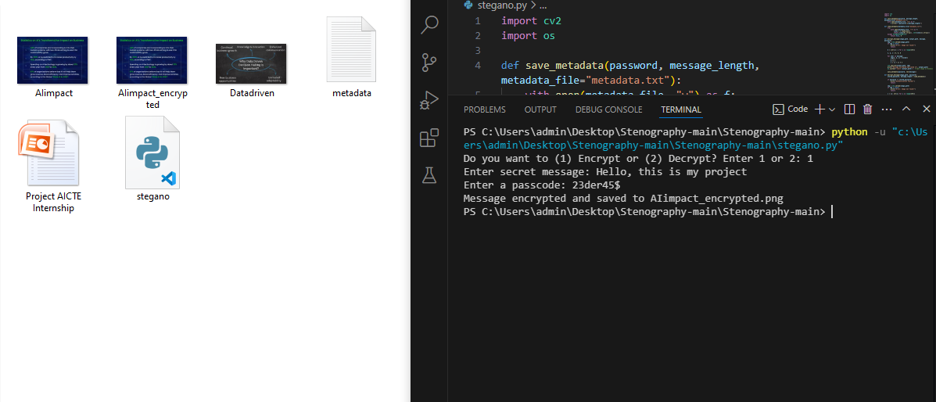
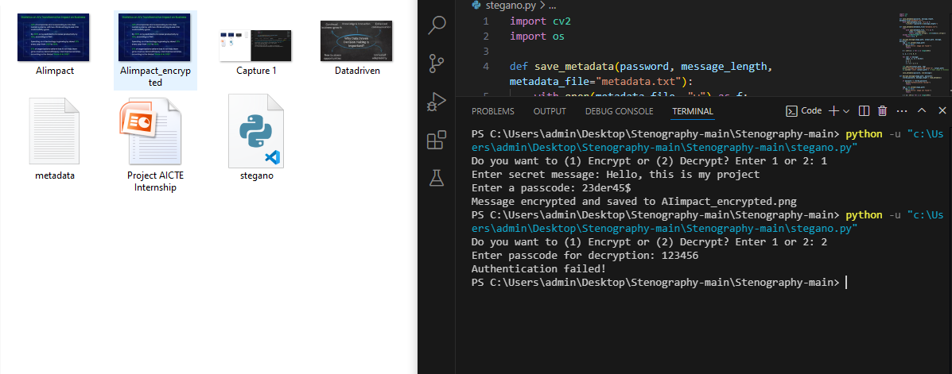
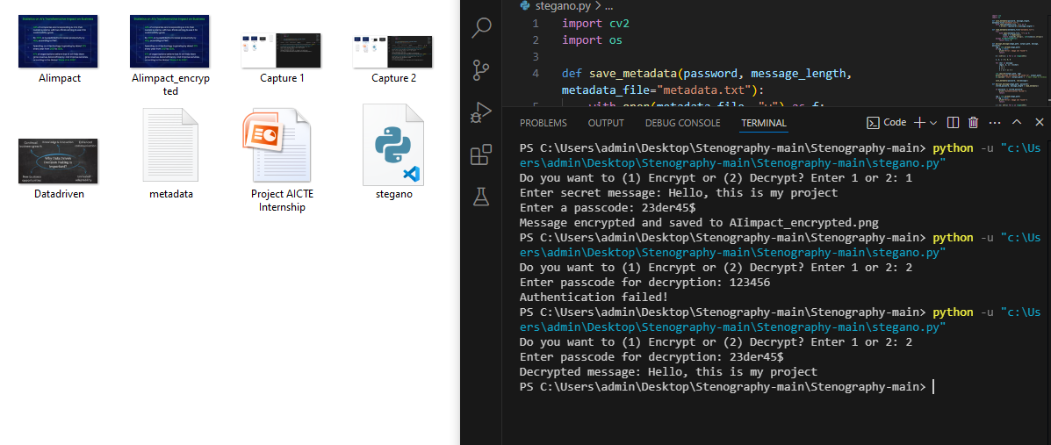
Results

Slide 8
Conclusion
With the rise of digital communication, ensuring the confidentiality of sensitive information has become increasingly critical. Traditional encryption techniques can make messages look suspicious when intercepted. Steganography provides a solution by hiding messages within digital media such as images, making the communication discreet and less likely to attract attention.
This project focuses on implementing image-based steganography using OpenCV in Python. The application allows users to securely embed a secret message within an image and retrieve it using a password. The encryption process alters pixel values in the image to encode the message, while the decryption process retrieves the original text if the correct passcode is provided. Additionally, metadata storage ensures that decryption is only possible with the exact password used during encryption.
The project addresses the following challenges:
Securely embedding a message without significantly altering the image.
Ensuring only authorized users can retrieve the hidden message.
Preventing loss of metadata between encryption and decryption.
This solution can be utilized in various security and privacy-sensitive applications, including covert communication, digital watermarking, and anti-tampering mechanisms.

Slide 9
GitHub Link
https://github.com/Shubham-Paliwal-06/Steganography.git

Slide 10
Future & scope
Enhanced Security with Stronger Encryption:
Integrating cryptographic algorithms (AES, RSA) to add an extra layer of security before embedding messages.
Support for Multiple Image Formats:
Extending compatibility beyond PNG to include JPEG, BMP, and other formats.
AI-Based Image Steganalysis Resistance:
Implementing advanced techniques to evade detection by AI-powered steganalysis tools.
Mobile and Web-Based Implementation:
Developing Android, iOS, or web applications for user-friendly and accessible message encryption.
Larger Data Embedding:
Optimizing algorithms to store larger amounts of text or even small files inside images.
Blockchain for Secure Message Verification:
Using blockchain technology to verify and track encrypted messages for added security.

Slide 11
THANK YOU

